Slide 1
Public Health Orientation Communicable Disease Prevention and Control
April 2018

Slide 2
Learning Objectives
At the end of this presentation the learner will:
Understand the goals and outcomes expected of communicable disease (CD) public health activities
Understand the importance of the chain of transmission in the prevention and control of communicable diseases
Understand the legislation relevant to CD prevention and control
Understand the FNIHB-OR regional CD program
Understand CD management
Understand how to fill out the Reportable Disease Form

Slide 3
Ontario Public Health Standards – Communicable Diseases
Goal
To reduce the burden of communicable diseases and other infectious diseases of public health importance.
Outcomes
Community is aware of and uses local data to influence and inform the development of local healthy public policy and its programs and services for the prevention of infectious and communicable diseases.
Health programs and services are designed to address the identified needs of the community, including priority populations, associated with infectious and communicable diseases.
Timely and effective detection, identification, and management of exposures and local cases/outbreaks of infectious and communicable diseases of public health importance, including diseases of public health significance, their associated risk factors, and emerging trends.
Effective case management results in limited secondary cases.
Reduced transmission of infections and communicable diseases.
Notes:
Link to goals and outcomes of PHUs.

Slide 4
What is a Communicable Disease?
An infectious disease transmissible (as from person to person) by direct contact with an affected individual or the individual's discharges or by indirect means (as by a vector) Merriam Webster Dictionary

Slide 5
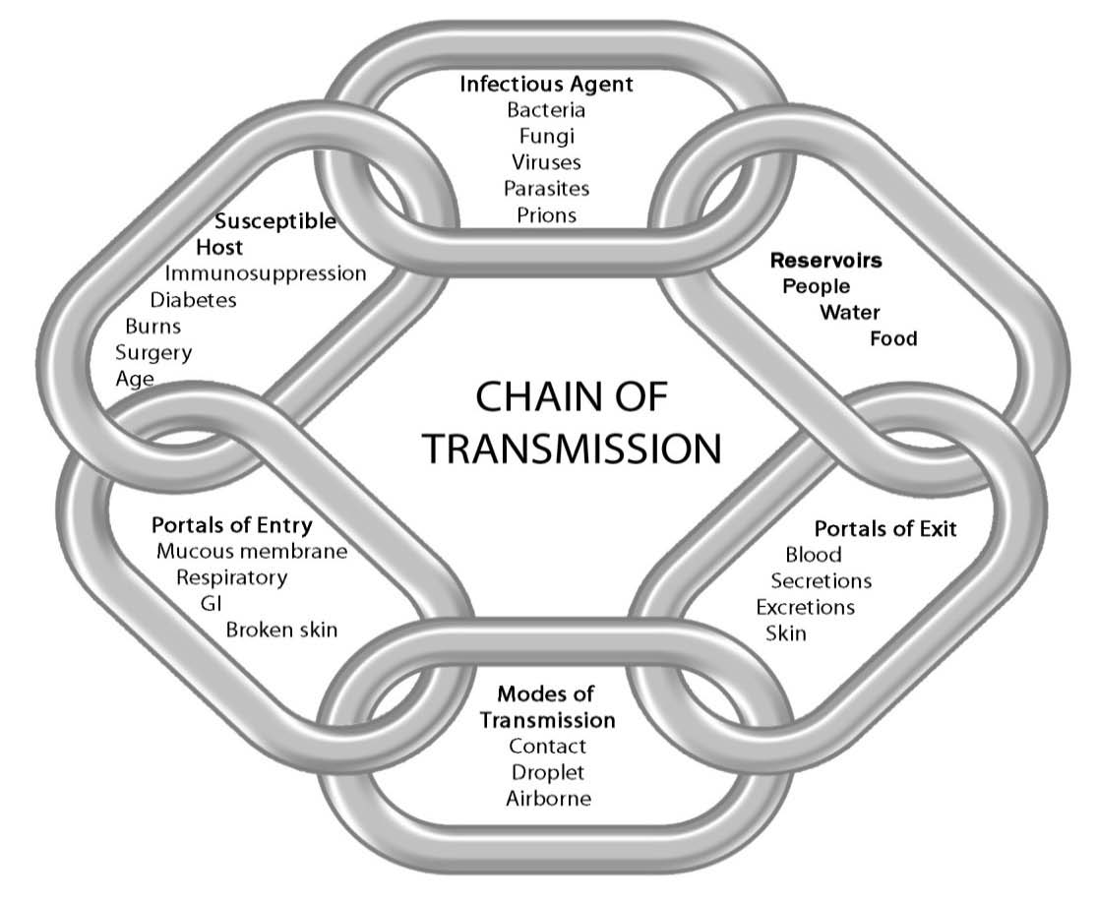
Chain of Transmission
Public Health Ontario. (2012). Routine Practices and Additional Precautions.
Notes:
The chain of transmission is a concept used to show how factors or “links” in a “chain” must be present in order for an infection or illness to occur. An infection can only happen if all six links in the chain are in place.
Explain the definition for each link in the chain and its role in transmission.

Slide 6
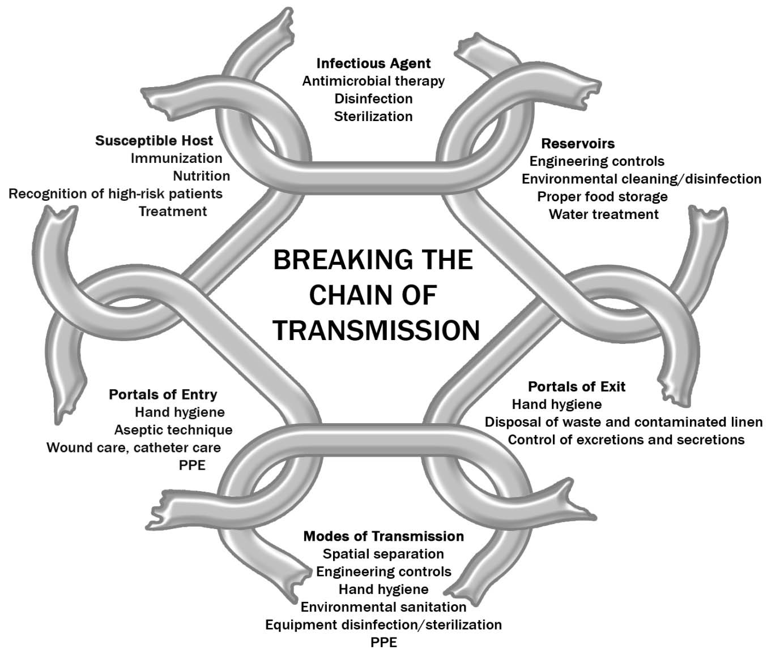
Breaking the Chain of Transmission
Public Health Ontario. (2012). Routine Practices and Additional Precautions
Notes:
The goal of communicable disease prevention and control is to break one or more links in the chain of transmission. The chain of transmission can lead to an infection ONLY if ALL of its links are in place. In order to stop the transmission of infectious agents, a link in the chain needs to be broken.
Discussion: Provide additional examples of how each link can be broken. (10 min)
Answers:
1. Infectious agent
The following practices either reduce or eliminate the number of microorganisms present:
a) Hand hygiene
b) Routine cleaning
c) Disinfection and/or sterilization of medical equipment and devices
d) Disposable of single use medical equipment and devices
2. Reservoirs
It is important to contain and control the location (or reservoir) of the infectious agent through:
a) Proper cleaning of the environment
b) Proper handling of garbage and waste
c) Disinfecting/sterilizing surfaces and equipment
d) Discarding any food that may have been left out on the counter
3. Portals of Exit
Infection control practices break the chain at the point where the infectious agent leaves the reservoir:
a) Hand hygiene
b) Environmental cleaning
c) Using personal protective equipment (PPE) to cover up portals of exit
o Ensuring coughs/sneezes are covered
o Covering wounds
o Safe disposal of body fluids
4. Modes of Transmission
Creating barriers and providing effective cleaning are ways to control the spread of infectious agents at this link in the chain.
Contact transmission is controlled by:
a) Hand hygiene
b) Personal protective equipment (PPE) such as disposable gloves, gowns and masks with face protection, and hand hygiene after removal of PPE
c) Environmental cleaning
d) Staff staying home when they are sick with something that may be infectious (e.g. rash, fever, cough or diarrhea)
e) Placing clients who are coughing and sneezing in a separate room if possible
Droplet transmission is controlled by:
a) Hand hygiene
b) Covering your cough or sneeze (respiratory etiquette)
c) Placing clients who are coughing and sneezing in a separate room if possible
d) Maintaining a space of 2 metres from a coughing or sneezing person
e) Using of personal protective equipment (PPE)
f) Staff staying home when they are sick with something that may be infectious (e.g. rash, fever, cough or diarrhea)
Airborne transmission is controlled by:
a) Hand hygiene
b) Using personal protective equipment (PPE) with an N95 Respirator and eye protection. Other PPE may be required.
c) Negative pressure rooms
d) Excluding staff with an airborne infection from work
e) Placing clients with a suspected airborne disease such as chickenpox, measles or tuberculosis in a separate room if possible
5. Portals of Entry
Using an effective barrier and other techniques can block the pathway by which the infectious agent can gain entry to the body, therefore breaking the chain.
a) Hand hygiene
b) Use of personal protective equipment (PPE)
c) Prevent skin breakdown
d) Safe use/handling of all sharps (needles etc.)
6. Susceptible host
A person can improve their chances of not becoming a susceptible host by:
Keeping their immunizations up to date including annual influenza immunization
b) Maintaining good eating habits
c) Exercising regularly

Slide 7
What are my legal requirements for CDCM?
Health Protection and Promotion Act
Diseases of Public Health Importance
Infectious Diseases Protocol: Appendix B
FNIHB-OR Reporting
Reportable Disease Form
Hepatitis Case Management Form
Tuberculosis Forms
Notes:
Provide hard copy of Reportable Disease List.

Slide 8
Health Protection and Promotion Act
The Health Protection and Promotion Act is the legislation that directs the management of communicable diseases in the province.
First Nations and Inuit Health Branch – Ontario Region adheres to this legislation and works in partnership with the Public Health Units in providing health services to First Nations living on reserve in accordance with the Act.
http://www.elaws.gov.on.ca/html/statutes/english/elaws_statutes_90h07_e.html
The HPPA lists Diseases of Public Health Importance (formerly called Reportable Disease List).
Any positive lab slip is reported to both the physician who ordered the test and the PHU for reporting purposes.

Slide 9
Health Protection and Promotion Act
The Communicable Disease Nurse at FNIHB or the CHN in the community (or both) are advised of the positive result for follow up.
Appendix B of the MOHLTC Infectious Diseases Protocol outlines the reporting requirements for each reportable disease, including what is considered a case. It indicates if confirmed and/or suspected cases must be reported.
While the MOHLTC tracks reportable diseases in a database called iPHIS, FNIHB does not have access to this information.
FNIHB has a parallel reporting system through the CD nurses, which captures the number of cases of reportable diseases that occur in First Nation communities.
All CHNs must submit the appropriate forms so that the surveillance system is accurate.

Slide 10
Practice Advisors – Public Health (CD Nurses) - Roles
Resource to CHNs, nurse managers and regional office
Orientation and ongoing education of CHNs specifically with regards to communicable disease
Provide assistance to CHNs in case and contact management of communicable diseases as needed
Quality assurance/improvement of reportable disease program
Surveillance/data collection
In the event of an outbreak, will play an integral role on the outbreak management team
Ensure open communication with CHNs, EHOs, local public health units, FNIHB-OR offices
Public health crises response, related to communicable diseases
Infection control
Planning/implementation/evaluation
Support nursing practice
Encourage and support CHN’s to network and partner with their local PHU.
Notes:
Provide hard copy of list of communities and contact info for each CD nurse. Review which CD nurse covers their community. If CD nurse and docs are in the office, provide face-to-face introduction (10 minutes).

Slide 11
Regional Communicable Disease Unit - Programs
Communicable Disease Control and Management
Immunization/Vaccine Preventable Disease
Tuberculosis
Sexually Transmitted and Blood Borne Infections (STBBI)
Public Health Emergencies
Infection Prevention and Control
Notes:
Each of these programs are explained in more detail during the orientation.

Slide 12
Communicable Disease Control and Management
Confirm Diagnosis
Review lab slip
Review Appendix B (IDP) to confirm case definition and if reportable
Case Management
Investigate history of the disease Counselling
Immunization or immunoglobulin
Contact Tracing
Prepare list based on mode of transmission and incubation period
Recommend testing or treatment
Prevention Activities
Surveillance and Reporting
Community education Community immunization blitz
Targeted education Harm reduction
Complete appropriate forms and submit to CD nurse
Monitor for increased cases in the community that may indicate an outbreak
Outbreak Management
Covered in subsequent presentation
Treatment of disease or symptoms if needed

Slide 13
Case Management - Exercise
Break into 6 groups (or individuals)
Assign a disease to each group
Chlamydia trachomatis
Chickenpox (Varicella)
Group A Streptococcal Disease, invasive (iGAS)
Hepatitis C
Influenza
Pertussis (Whooping Cough)

Slide 14
Case Management Exercise - Continued
Answer the following questions for your group’s disease.
What is the case definition for your disease?
When is it reportable?
What are the disease characteristics?
What is the mode of transmission?
What is the period of communicability?
What is the treatment?
Is contact tracing necessary? If so, who is considered a contact?
Report your answers back to the large group.
Notes:
Participants should have access to the Infectious Disease Protocol electronically as well as Heymann’s and use these for this exercise. (20 min)

Slide 15
Contact Tracing
A systematic process to:
Identify people that have been exposed to a communicable disease
Assess people for signs and symptoms of the communicable disease
Provide/confirm appropriate treatment or chemoprophylaxis for the disease, if required
Notes:
Identifying who has been exposed requires knowledge of the mode transmission as well as the incubation period of the disease.
Assessing people for signs and symptoms requires knowledge of the disease characteristics, as well as the appropriate testing required and what it tells you.
Providing appropriate treatment or chemoprophylaxis requires knowledge of the resources available that outline treatment or chemoprophylaxis options for each disease. Examples include the Canadian STI Guidelines, the Canadian Tuberculosis Standards. While the CHN may not be initiating treatment, (s)he should confirm the correct treatment was given, or confirm that a referral was made to the appropriate health care professional.

Slide 16
Prevention Activities
Need to target the individual, family, groups and the community at large
Vulnerable populations may need their own focus and interventions.
Requires skills in health promotion and community development.

Slide 17
Prevention Activities - Exercise
Form the same groups with the same disease as the case management exercise. Answer the question for your disease.
What community level prevention activities can be applied if you have a case of pertussis (whooping cough)? What community partners would you involve?
What community level prevention activities can be applied if you have a case of iGAS? What community partners would you involve?
What individual level prevention activities can be applied if you have a case of chlamydia?
What individual level prevention activities can be applied if you have a case of chickenpox (varicella)?
What vulnerable groups should you address and what should your messaging be for influenza?
What vulnerable groups should you address and what should your messaging be for hepatitis c?
Notes:
Report back to larger group. Use information in Appendix A and Heymann’s to determine messaging. (15 min)

Slide 18
Surveillance – Reportable Disease Form
Notes:
Surveillance in FNIHB will be covered in another presentation by the epidemiologist. This section will just review the RDF. Other reporting forms for hepatitis and TB will be covered in their presentations later as well.
Provide a hard copy of the RDF
Review fields in form to be filled in.

Slide 19
Surveillance – Reportable Disease Form - Continued
Notes:
Exercise
Have participants fill out the form for the disease they had reviewed earlier (they will need to make up some information). (10 min)

Slide 20
References
FNIHB-OR. www.onehealth.ca
MOHLTC. (2018). Infectious Diseases Protocol. Retrieved from: http://www.health.gov.on.ca/en/pro/programs/publichealth/oph_standards/infdispro.aspx
MOHLTC. (2018). Ontario Public Health Standards. Retrieved from: http://health.gov.on.ca/en/pro/programs/publichealth/oph_standards/docs/protocols_guidelines/Ontario_Public_Health_Standards_2018_en.pdf

Slide 21
Regional Communicable Disease Unit - Staff
Director of Public Health – Dr. Rosemarie Ramsingh
Medical Officer – Dr. Jo Ann Majerovich
A/Communicable Disease Manager – Teresa Gillespie
Practice Consultant: Public Health – Leanne Coward
Practice Advisor: Public Health (Communicable Disease nurses)
Innocent Magocha
Susan Conway
Maritza Lima
A/Communicable Disease Education Coordinator – Melissa Gregory
Regional Epidemiology Manager – Marene Gatali
Epidemiologists
Michelle Haavaldsrud
Melanie Varin

